Slide 1
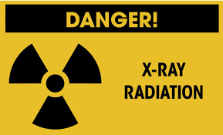
X-ray hazards
Dr. Ashraff Abdulrazaq

Slide 2
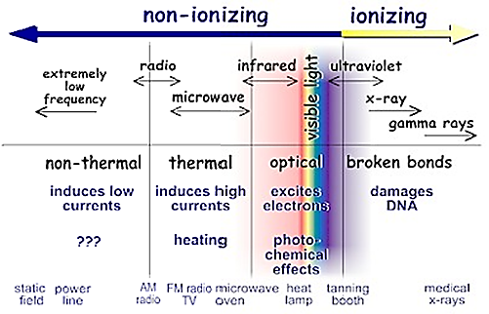
X- ray radiation
Invisible electromagnetic radiation with short wave length and high penetration power , can be used for diagnosis

Slide 3
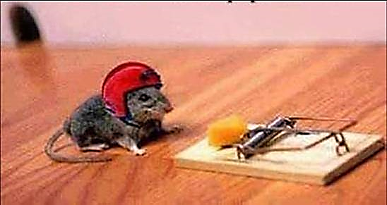
X- ray radiation
■ There are two types of risks produced in the field
of radiation:
1-Somatic risk
2-Genetic risk

Slide 4
X- ray radiation
1■ Somatic risk
(Biologic effect of ionizing radiation)
● Acute radiation sickness (vomiting, diarrhea)
● Chronic radiation sickness (leukemia)
● Skin and tissue burns
● Alopecia
● Temporary or constant infertility

